Slide 1
Systems Analysis and Design 11th Edition
Toolkit B – The Systems Analyst’s Toolkit CASE Tools

Slide 2
Chapter Objectives
Explain CASE tools and the concept of a CASE environment
Trace the history of CASE tools and their role in a fourth-generation environment
Define CASE terms and concepts, including a repository, modeling tools, documentation tools, engineering tools, and construction tools

Slide 3
Chapter Objectives (Cont.)
Explain an integrated development environment (IDE) and application life cycle management (ALM) solutions
Provide examples of CASE tool features
Describe CASE tool trends, and how they relate to object-oriented analysis and agile methods

Slide 4
Overview of CASE Tools
Every type of work requires specific tools to do the job properly
Carpenters use hammers, drills, or screwdrivers
Chefs use measuring cups, knives, or spatulas
System development is no different
CASE tools reduce costs, speed up development, and provide comprehensive documentation for future maintenance or enhancements

Slide 5
Overview of CASE Tools (Cont. 1)
CASE Tools History
Traditional code was written in procedural programming languages such as COBOL
Modern languages are non-procedural or event driven programming languages
Make it easier to implement an object-oriented design
Fourth-generation language environment includes modern CASE tools
System developers can deliver high quality software, shorten the timetable, and reduce expense

Slide 6
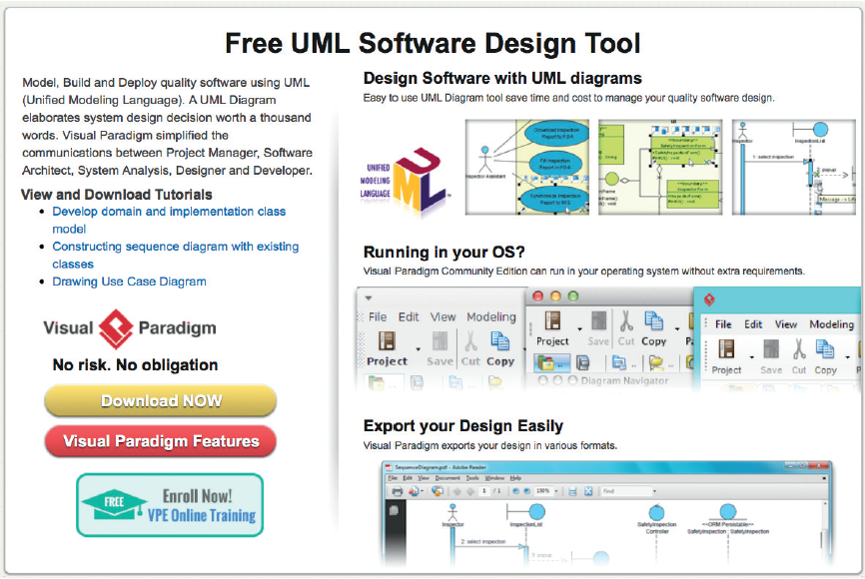
Overview of CASE Tools (Cont. 2)
The Marketplace for CASE Tools
There is a wide variety of vendors and products
No one tool dominates the market
FIGURE B-2 Visual Paradigm offers a free UML diagramming tool.
Source: Visual Paradigm

Slide 7
Overview of CASE Tools (Cont. 3)
Selection of a CASE tool depends on:
The type of project
The size and scope of the project
Possible budgetary and time constraints
Preferences and experience of the system development team

Slide 8
CASE Terms and Concepts
Repository
Database that serves as a central storage location for all information about the system being developed
Once a data element has been defined in the repository, it can be accessed and used by processes and other information systems

Slide 9
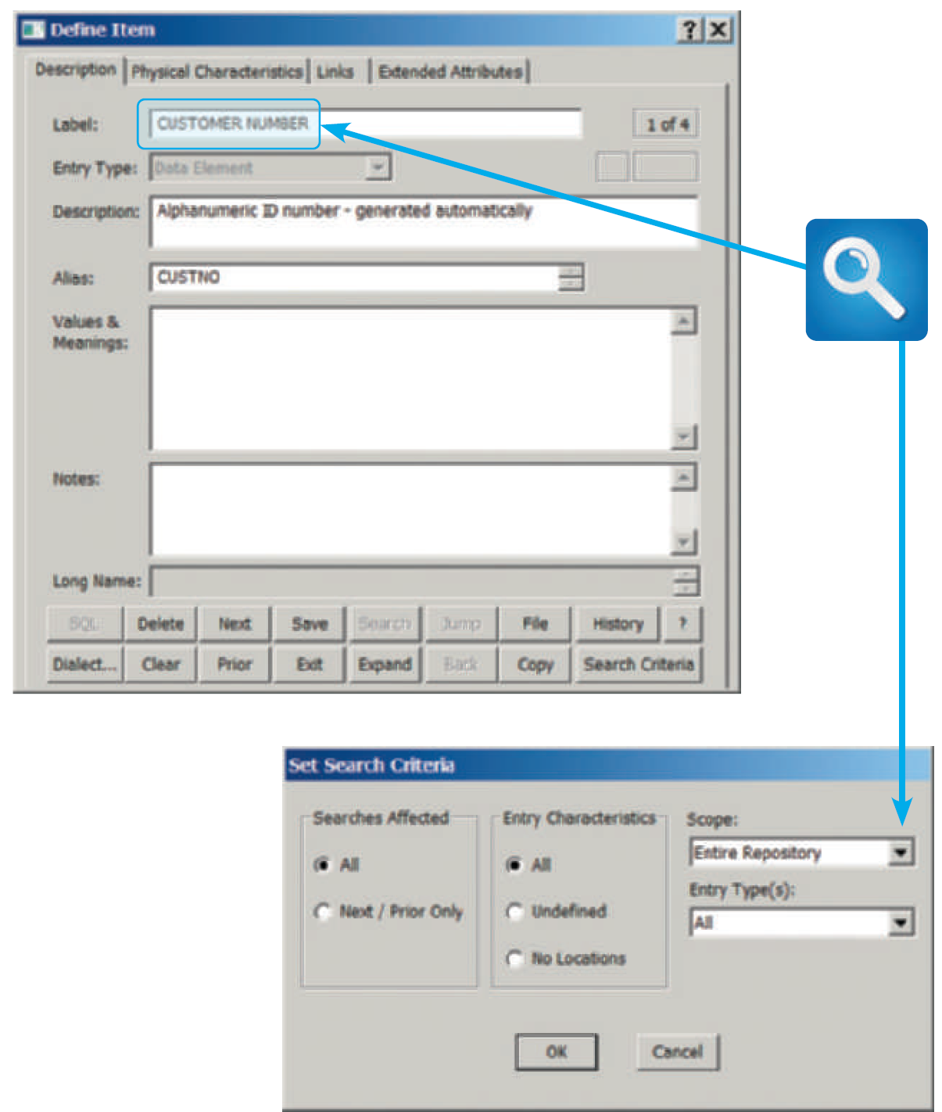
CASE Terms and Concepts (Cont. 1)
FIGURE B-3 A Visible Analyst repository search for the data element named CUSTOMER NUMBER. The results will show all instances of the data element.
Source: Visible Systems Corporation

Slide 10
CASE Terms and Concepts (Cont. 2)
Individual Tools
Used to model, document, engineer, and construct the information system
Modeling tools
Unified Modeling Language diagrams and functional decomposition diagrams (Chapter 4)
Data flow diagrams (Chapter 5)
Object diagrams (Chapter 6)
Entity-relationship diagrams (Chapter 9)
Structure charts (Chapter 10)

Slide 11
CASE Terms and Concepts (Cont. 3)
Documentation tools
Used to check for inconsistent or incomplete information in forms, reports, and diagrams
Engineering tools
Forward engineering: Translating business processes into applications
Reverse engineering: Helps break down an existing application into diagrams, structure charts, and source code

Slide 12
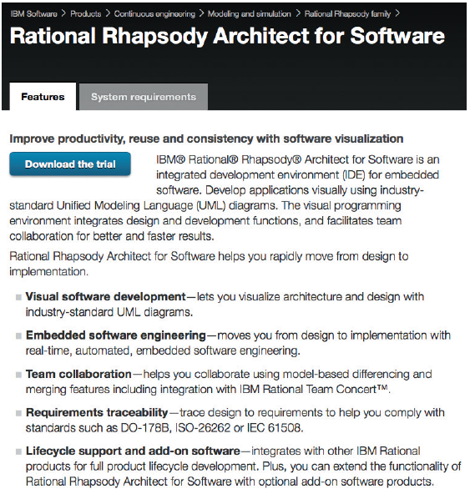
CASE Terms and Concepts (Cont. 4)
Construction tools
Application generator (code generator): Used to develop computer programs rapidly by translating a logical model directly into code
FIGURE B-4 IBM Rational Rhapsody can generate source code from UML diagrams.
Source: IBM Corporation

Slide 13
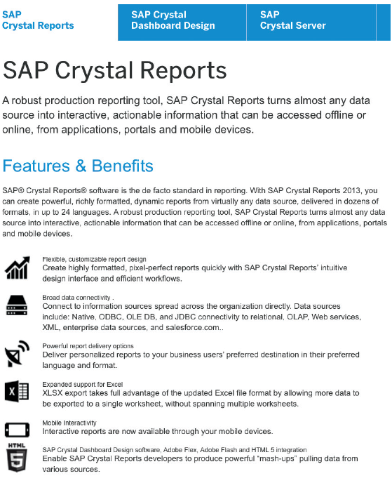
CASE Terms and Concepts (Cont. 5)
Screen generator (form painter): Helps design a custom interface, create screen forms, and handle data entry format and procedures
Report generator (report writer): tool for designing formatted reports rapidly
FIGURE B-5 SAP Crystal Reports is a popular report generator that can display business analytics and support decision making.
Source: SAP SE

Slide 14
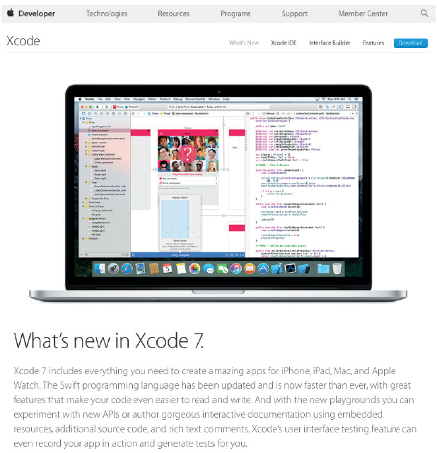
Development Environments
Mix of software tools, methods, and physical resources used to create an information system
Integrated Development Environment (IDE)
Uses built-in tools provided by the software vendor that make it easier to create applications based on their products
FIGURE B-8 Xcode is free IDE for all of
Apple’s platforms.
Source: Apple Inc.

Slide 15
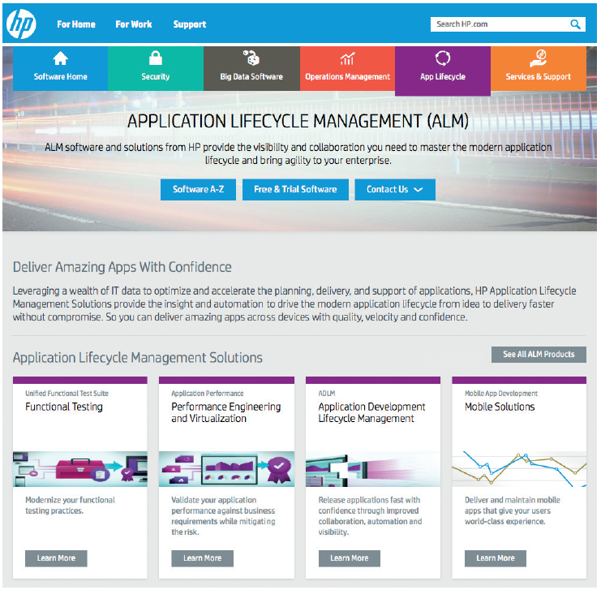
Development Environments (Cont. 1)
Application Life Cycle Management Environment
Start-to-finish approach to planning, designing, developing, deploying, managing, and maintaining an information system
Part of product life cycle management (PLM)
FIGURE B-9 HP provides a full range of application lifecycle management software solutions.
Source: Hewlett Packard Enterprise Development LP.

Slide 16
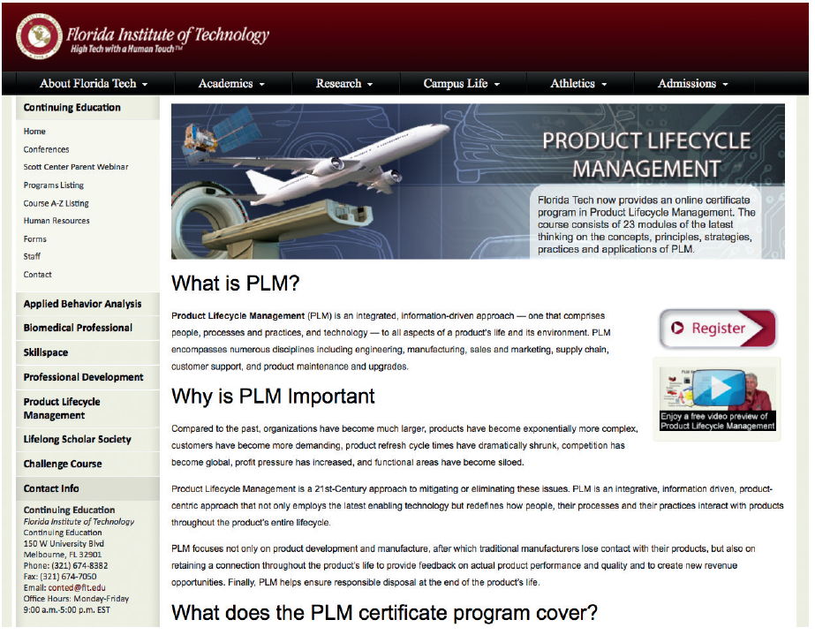
Development Environments (Cont. 2)
FIGURE B-10 PLM encompasses numerous disciplines, and is broader than ALM.
Source: Florida Institute of Technology.

Slide 17
Development Environments (Cont. 3)
Pros and Cons of Integrated Development Tools
An integrated development tool is highly effective in a specific software environment as it is built into the vendor’s software package
Non-specific CASE tools such as Visible Analyst or Rational System Architect can be used in any development environment
Disadvantage - Each IDE is different
Requires a learning curve and skills that might or might not be readily transferable

Slide 18
CASE Tool Trends
New Products and Features
CASE tool vendors constantly offer more features and greater flexibility
Framework: Organizes and documents system development tasks
Helps transform business processes into an information system
Example - Zachman Framework
Microsoft Visio - Models networks, business processes, and diagrams
Cloud-based development environments
Example - Heroku platform

Slide 19
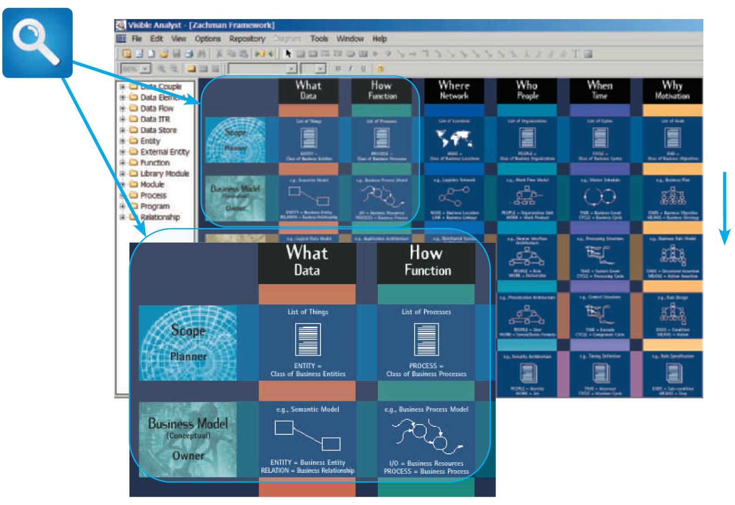
CASE Tool Trends (Cont. 1)
FIGURE B-11 The Zachman Framework in Visible Analyst provides an easy-to-follow matrix that helps system developers work on specific areas, and then integrate the results into an overall model.
Source: Visible Systems Corporation.

Slide 20
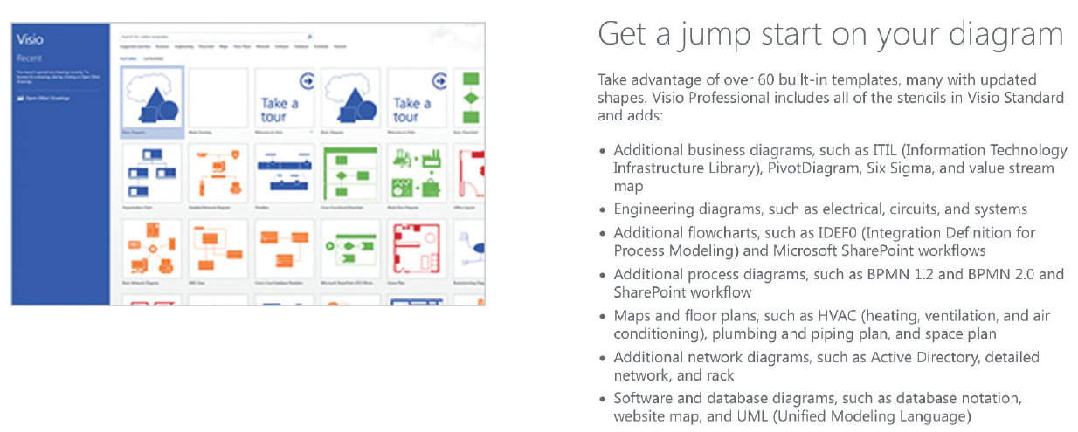
CASE Tool Trends (Cont. 2)
FIGURE B-12 Microsoft Visio can create many different types of diagrams.
Source: Microsoft Corporation.

Slide 21
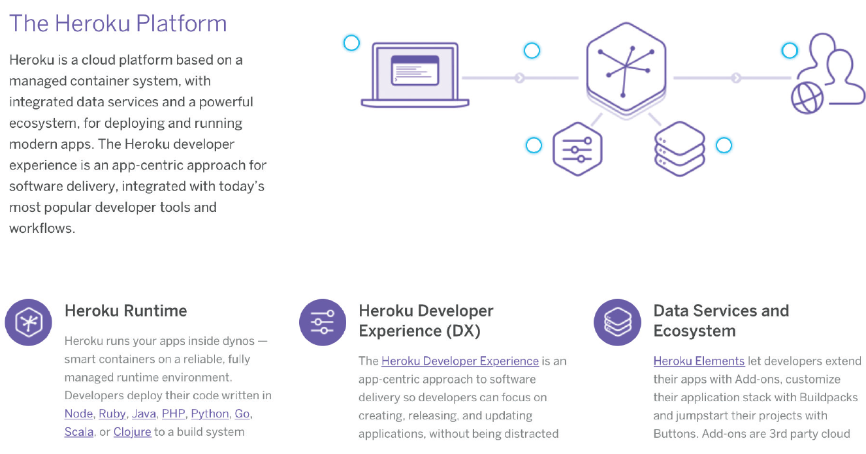
CASE Tool Trends (Cont. 3)
FIGURE B-13 The Heroku platform in the cloud.
Source: Salesforce.com

Slide 22
CASE Tool Trends (Cont. 4)
Method-Specific CASE Tools
Each development approach has a set of tools that works especially well for that method
Structured development relies heavily on DFDs and structure charts
Object-oriented methods use diagrams, such as use case, class, sequence, and transition state diagrams
Agile methods use spiral or other iterative models
Structured analysis - Traditional approach that is time tested and easy to understand

Slide 23
CASE Tool Trends (Cont. 5)
Object oriented analysis and design (OOAD)
O-O CASE and UML-based modeling tools provide seamless development from planning to actual coding
Include modular design and reusable code
Agile methods
Agile developers use a wide range of modeling tools including CASE tools
CASE tools will continue to evolve and become more powerful
System developers may choose simpler, low-tech methods and techniques as modeling tools

Slide 24
Toolkit Summary
CASE stands for computer-aided systems engineering
CASE tools help design and construct information systems
Modern languages are non-procedural
Components of a fourth-generation environment
Repository is a database that serves as a central storage location for all information on the system being developed
Main source of system documentation

Slide 25
Toolkit Summary (Cont.)
Forward engineering means translating business processes and functions into applications
Reverse engineering helps examine and break down an existing application
IDE uses a built-in CASE tool included by vendors
Vendors are calling attention to ALM concepts and tools
Cloud-based toolsets will continue to grow in popularity

